Slide 1
Types (Genres) of Essays
MR. WILLIAMS’ AP ENGLISH LANGUAGE CLASS

Slide 2
Analogy
The writer wishes to explain why. Types of causes are the immediate causes (apparent), which are encountered first, and the ultimate causes, which are the basic, underlying factors that explain the more apparent causes.
To explain something abstract or complex by showing its similarity to something simpler and more concrete.
For the analogy to be effective, the writer should assume that the reader is familiar with the subject. The main purpose of the analogy is to explain.
Cause and Effect

Slide 3
Classification
The author divides the subject into categories or other systems to analyze the material, such as types, sizes, number, appearance, prevalence, etc. The system needs to be logical and consistent throughout the essay.
When we show , in writing, the similarities and differences between two subjects, we are asking readers to look more closely at each. Sometimes writers look only to suggest how two things are alike, or may want to show the superiority of one thing over another.
Compare and Contrast

Slide 4
Definition
This is either objective (factual, not nan impression or opinion) or subjective (filtered through the writer’s perspective and his/her opinion); subjective description begins in fact.
Careful description helps readers see things more clearly, understand abstract concepts more simply, and appreciate ideas and events in a more personal way. Imagery and sensory language nearly always engage the reader emotionally. In such an essay, the writer hopes to present a single, dominant impression.
When terms need clarification because they are ambiguous, abstract, unusual, or otherwise not generally understood, the writer will seek to define them for the reader, especially if the overall explanation relies on an understanding of these terms.
Ways to define are: Exclusion or differentiation, which shows what is not meant by the term (clarification by negation).
Examples to illustrate the definition (extended definition), will most likely do more than simply define. Writer seeks to bring out a greater senses of understanding on an important topic or issue. An example defining the word “Thot” or “nerd.”
Description

Slide 5
Exemplification
There are 2 kinds: a set of directions, how to do something; and an information process, which explains how something is done or how it works or operates. A process analysis essay can be written in chronological order, that is, the order of the steps in the process (first, next, etc.).
Some processes are more complicated and require a different approach. A historian who writes about how civil rights activities registered voters would not necessarily follow a chronology of events.
Uses examples to put abstract or complex ideas into simpler, more concrete form. To support an argument, a writer must choose a clearly typical example or present several examples that represent the situation fairly. Examples must be relevant or pertinent to the argument.
Process

Slide 6
Expository
Non-Fiction
Fiction
Creative endeavors through a variety of methods.
This is one that explains or explores a topic using a variety of methods.
Novels
Poetry
Plays
Description
Narrative
Cause and Effect
Problem/Solution
Process Analysis
Definition
Compare/contrast

Slide 7
Description
Used commonly by nature and environmental writers, description relies on imagery and colorful diction to get the reader to “see” the subject.

Slide 8
Narrative
Memoirs -
A personal narrative that reflects upon one’s own life experiences.
Focus on a key aspect, theme, event, or choice in a life
Start anywhere and can deftly move around in time and place. Less chronological and encompassing that a typical autobiography.
Feel more personal; less intense fact-checking
Strive for emotional truths
Can be written by anyone
The writer will explore a topic using the framework of a story, perhaps a look at one person’s life as a model or example of the main subject. Examples of this are: autobiographies, biographies, memoirs.
Autobiographies –
Focus on the trajectory of an entire life
Start at the beginning and progresses chronologically to the end
Feel more like a historical document; tons of fact-checking and very specific dates/information
Strive for factual, historical truths
Typically is written by famous people
May read less like a novel (than memoirs)
Biography –
A third-person account of another’s life.

Slide 9
Cause and Effect
Show why something happens, the series of events leading to or causing a concluding event.
Look for a problem or a current issue and the writer’s theories about the underlying causes.
You will probably be asked to defend, challenge, or qualify.

Slide 10
Problem Solution
An obvious Problem, in policy usually, will be presented along with one or more viable solutions.
You will probably be asked to defend, challenge, or qualify.

Slide 11
THERE’S NOTHING HERE. JUST TAKE A BREAK!

Slide 12
Process Analysis
If you recognize a process (how something works or operates) in a text, you can identify it and analyze its elements.
There are 2 kinds: a set of directions, that is, how to do something; and an information process, which explains how something is done or how it works or operates. A process analysis essay can be written in chronological order.; while, others may be more complicated and require a different approach.
The writer shows how something is done or how something works.

Slide 13
Compare/Contrast
Often, you will be asked to do this as your main task (such as compare/Contrast two texts), but even if you aren’t, you may have a reason to show similarities and differences and draw conclusions about what is revealed or communicated in the process..
As you read or write about comparisons and contrasts these are words to use or look out for:
To compare – In the same way, also, Likewise, Similarly,
To contrast – conversely, however, rather, on the contrary, on the other hand, yet

Slide 14
Synthesis
This is a short research paper.
You are given several resources to use in support of a thesis that you develop after you read the prompt and the resources.
Look for commonalities in the resources – make notes of them.

Slide 15
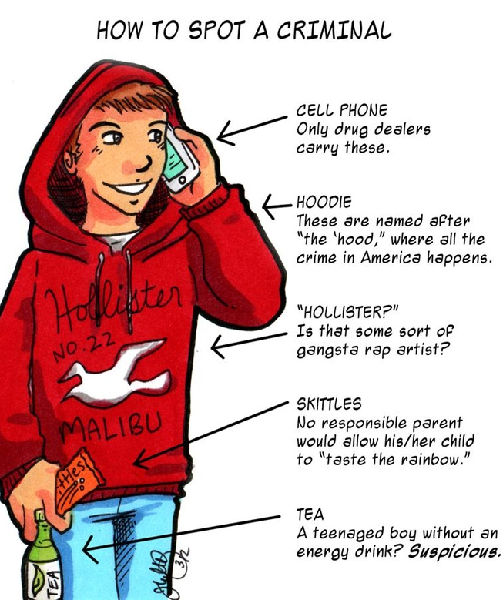
satire
A satirist seeks to improve society by showing its faults through irony and humor, either with a friendly nudge or sharp-edged jabs.
A feature of satire is strong irony or sarcasm—"in satire, irony is militant“⁻but parody, burlesque, exaggeration, juxtaposition, comparison, analogy, and double entendre are all frequently used in satirical speech and writing
Types are: (A) Horatian & (B) Juvenalian
Allegory
Horatian – light-hearted humor
Juvenalian – harsh and abrasive

Slide 16
Purpose of Essays
Inform | To give information, clearly and objectively
Persuade | To convince another to adopt a point of view or engage in an action.
Entertain | To provide humor and a pleasant escape
Satirize | To point out flaws in people or institutions with the intent of making positive change.
Inspire | Through one’s own experiences or observations, provide models that guide or give hope to others.
Reflect | To think back upon, to put into perspective. Reflection is typically personal, but thinks of the self in relation to others, to history, or to events in time.
Document | To mark in time, to record the significance of some event or action.

